Slide 1
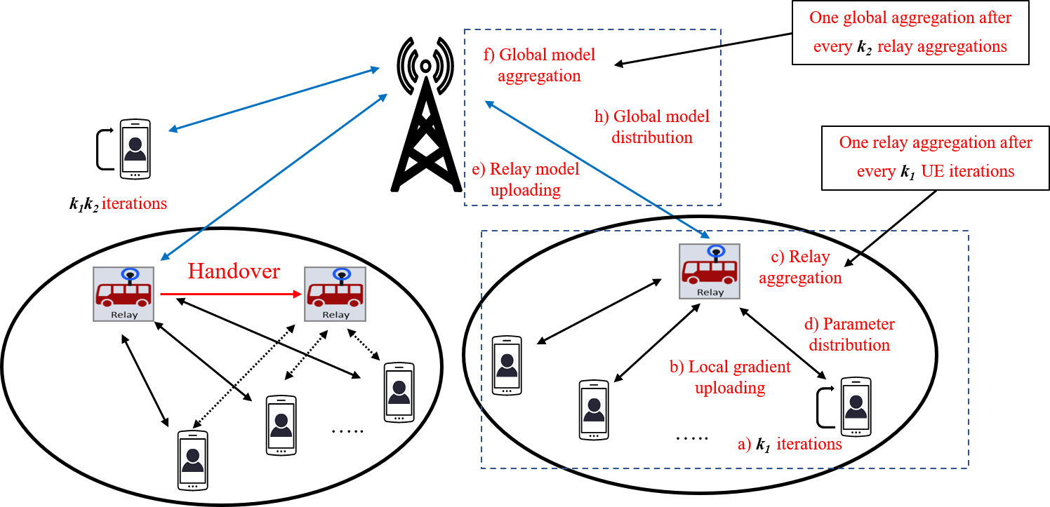
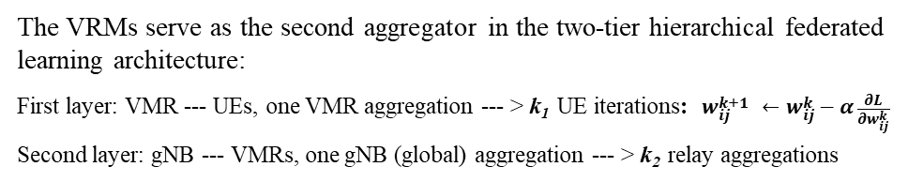
A Handover Scheme for Service Continuity in VMR-aided Hierarchical Federated Learning
Scenario:
Solution:
The VRMs serve as the second aggregator in the two-tier hierarchical federated learning architecture:
First layer: VMR --- UEs, one VMR aggregation --- > k₁ UE iterations: $w_{ij}^{k+1} ←w_{ij}^{k}−α\frac{∂L}{∂w_{ij}^{k}}$
Second layer: gNB --- VMRs, one gNB (global) aggregation --- > k₂ relay aggregations
T_remain --- estimated VMR i stay time;
T_1 --- The time for gNB to finish global aggregation in this round, i.e., we have (k’₁ < k₁) relay aggregations left
T_2 --- The time for gNB to finish global aggregation in next round (k₁ relay aggregations)
T_train = T_1 +T_2
Problem:
If T_remain > T_train, no handover;
If T_1 < T_remain < T_train, handover after global aggregation in this round is finished
Note：all VMRs ,UEs and the gNB share the same global model at handover.
VMR i handover to VMR j
If T_remain < T_1,
t_1 --- The time for VMR to finish relay aggregation in this round, i.e., we have (k’₂ < k₂ ) UE iterations left
t_2 --- The time for VMR to finish k₂ UE iterations in next round
t_train = t_1 +t_2
T_remain > t_train, no handover
t_1 < T_remain < t_train, handover after relay aggregation is finished in this round, VMR i send local Model to VMR j to finish the rest.
T_remain < t_1, VMR i force an aggregation and handover to VMR j , then it does what is in d)
SP 211648 FS_AIMLsys: WT#1.1 c. Enhancements of external parameter provisioning to 5GC (e.g. expected UE activity behaviors, expected UE mobility, etc.) based on Application AI/ML operation.
Standard impact:
1. T_1, T_2，t_1, t_2 are new signalings, need to upload to gNB as handover decision at gNB，
2. The choice of k₁ and k₂ have impact on service continuity
SP 211636 FS_VMR: WT#1. efficient mobility and service continuity for UE or a group of UEs to efficiently deliver data during different mobility scenarios (including mobility of the mobile base station relays).

